Slide 1
Discrete Mathematics
Spring 2020
Yuan Ze University

Slide 2
Fermat’s little theorem

Slide 3
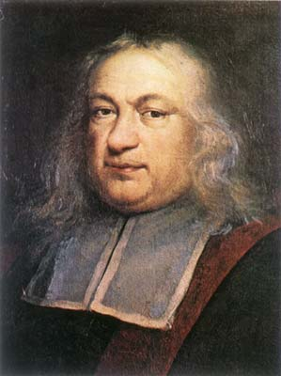
Pierre de Fermat (?–1665)

Slide 4
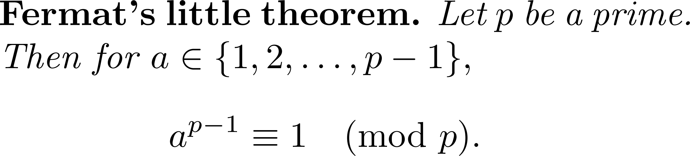

Slide 5
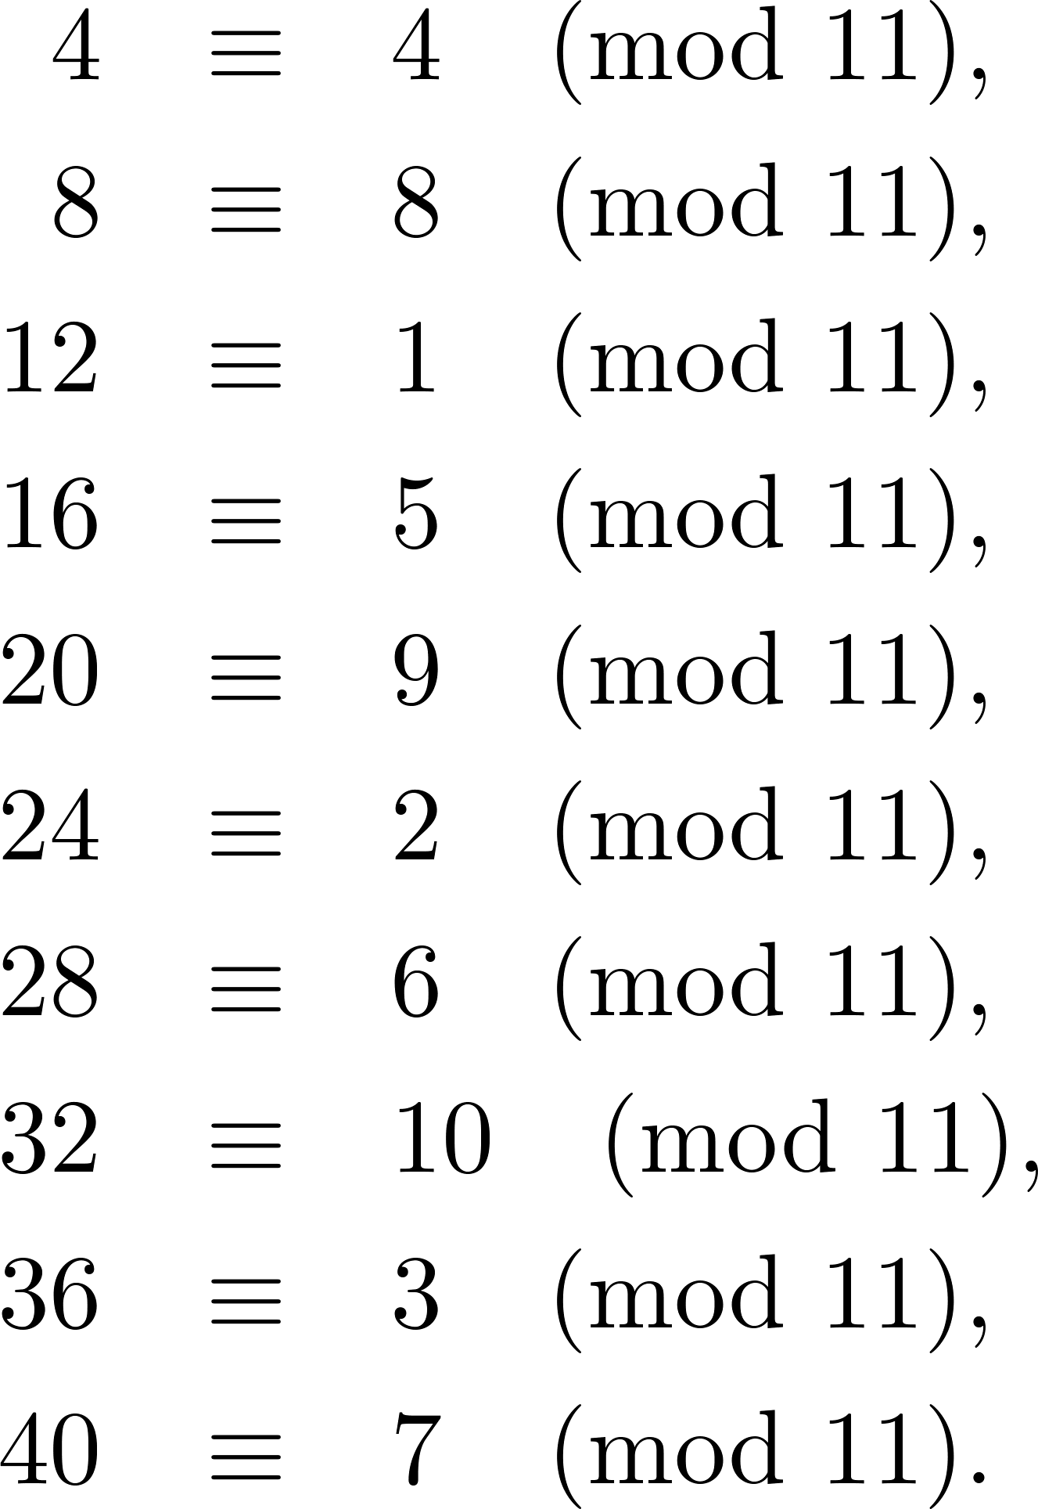
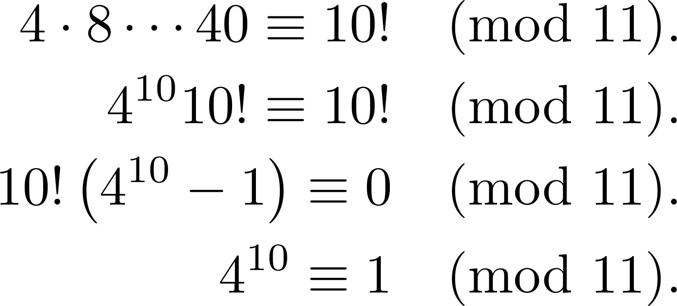
An illustration

Slide 6
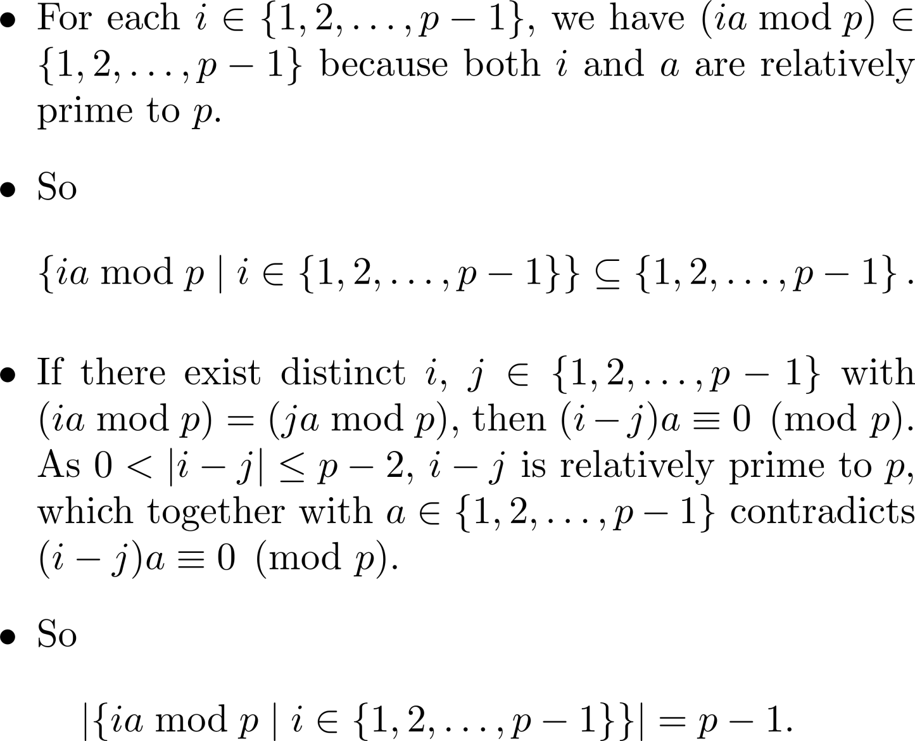
Proof (1/2)

Slide 7
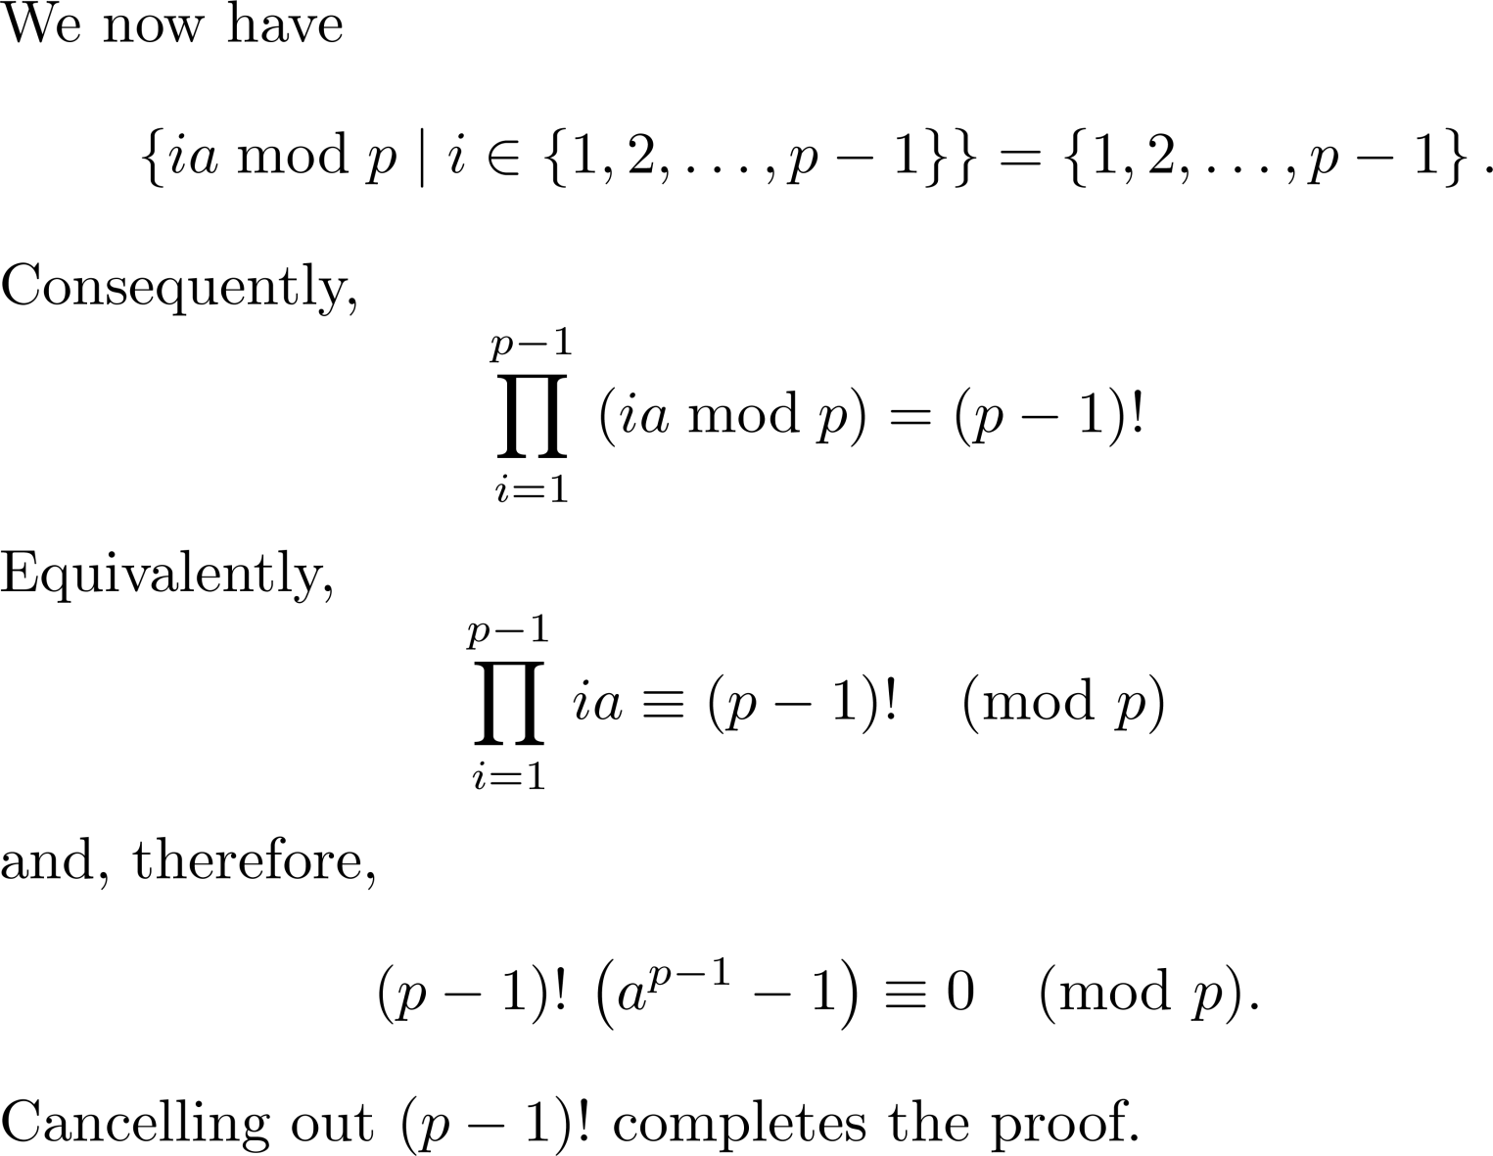
Proof (2/2)

Slide 8
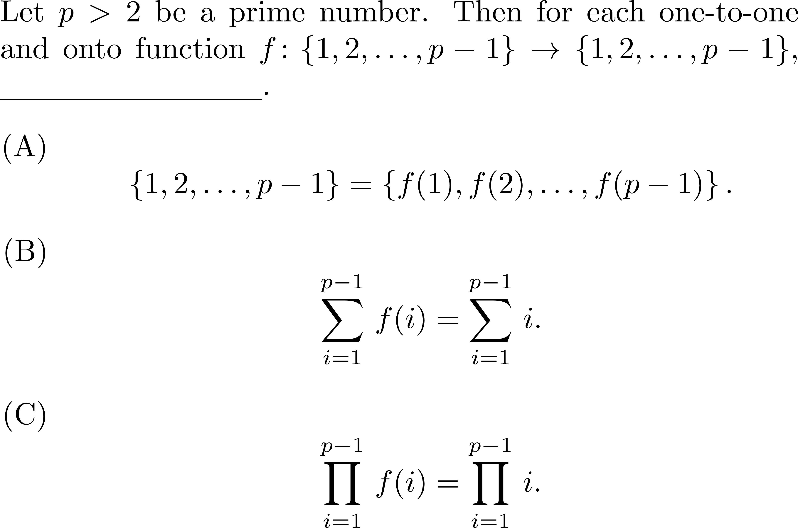
Fill the blank ☺

Slide 9
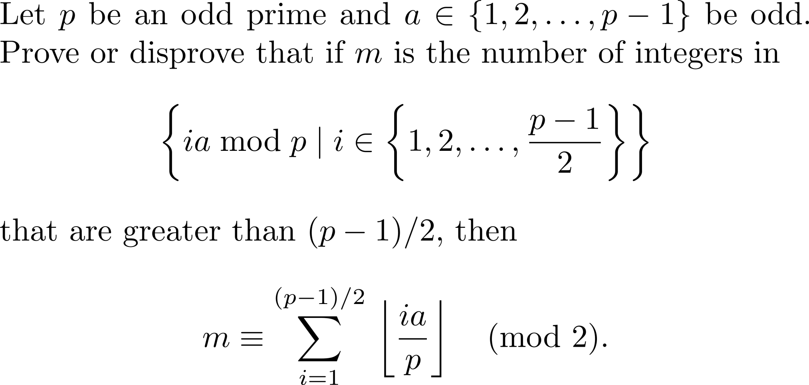
Something deeper
See this.

Slide 10
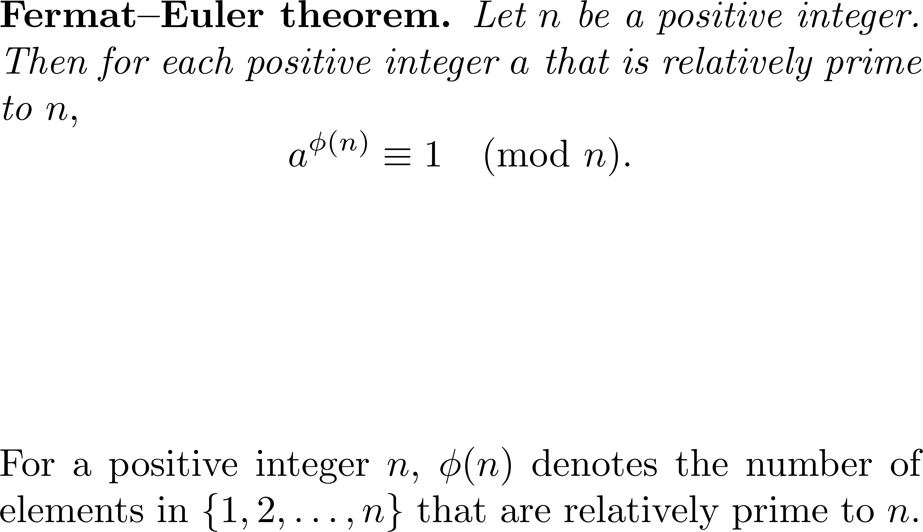
A generalization

Slide 11
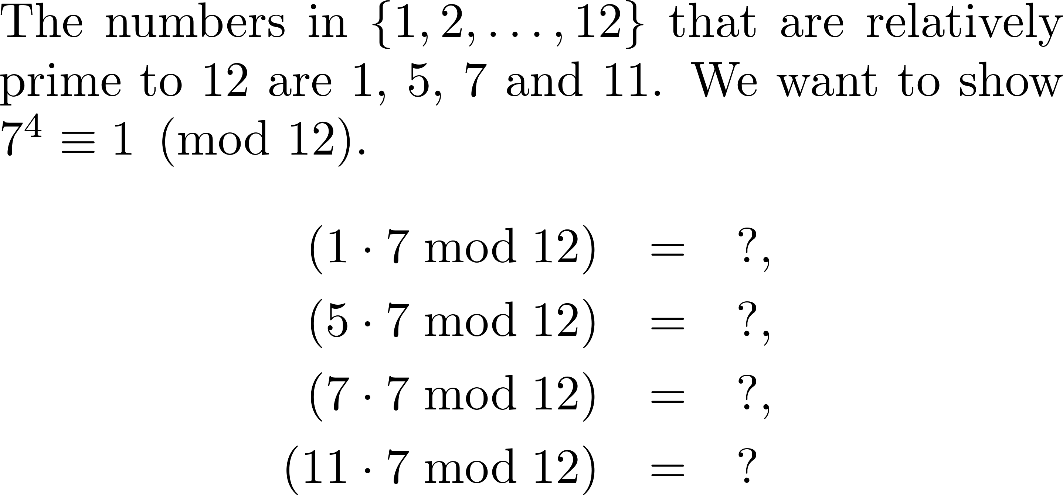
An example (1/3)

Slide 12
An example (2/3)
Not gonna repeat

Slide 13
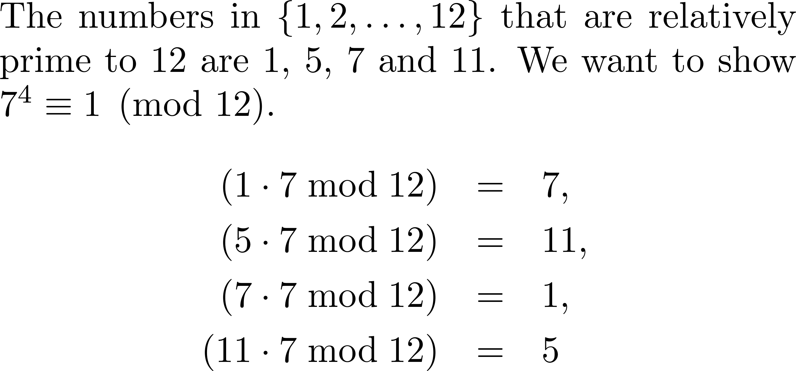
An example (3/3)
So it’s necessarily so…

Slide 14
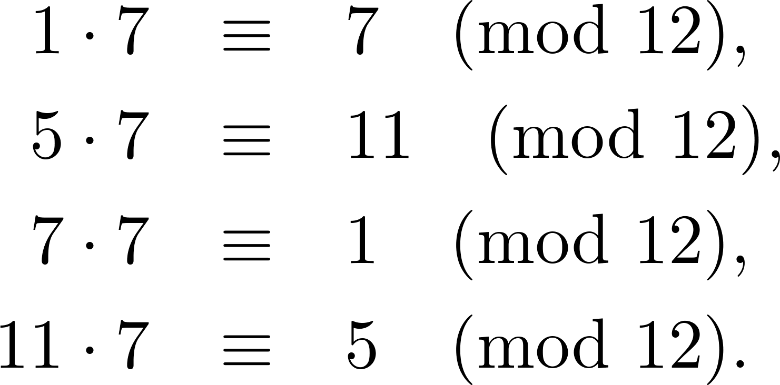
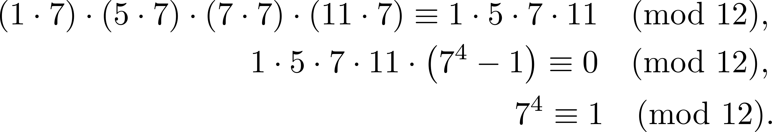
Calculations

Slide 15
Exercise
Give a formal proof of the Fermat–Euler theorem.

Slide 16
Questions?

Slide 17
Another theorem

Slide 18
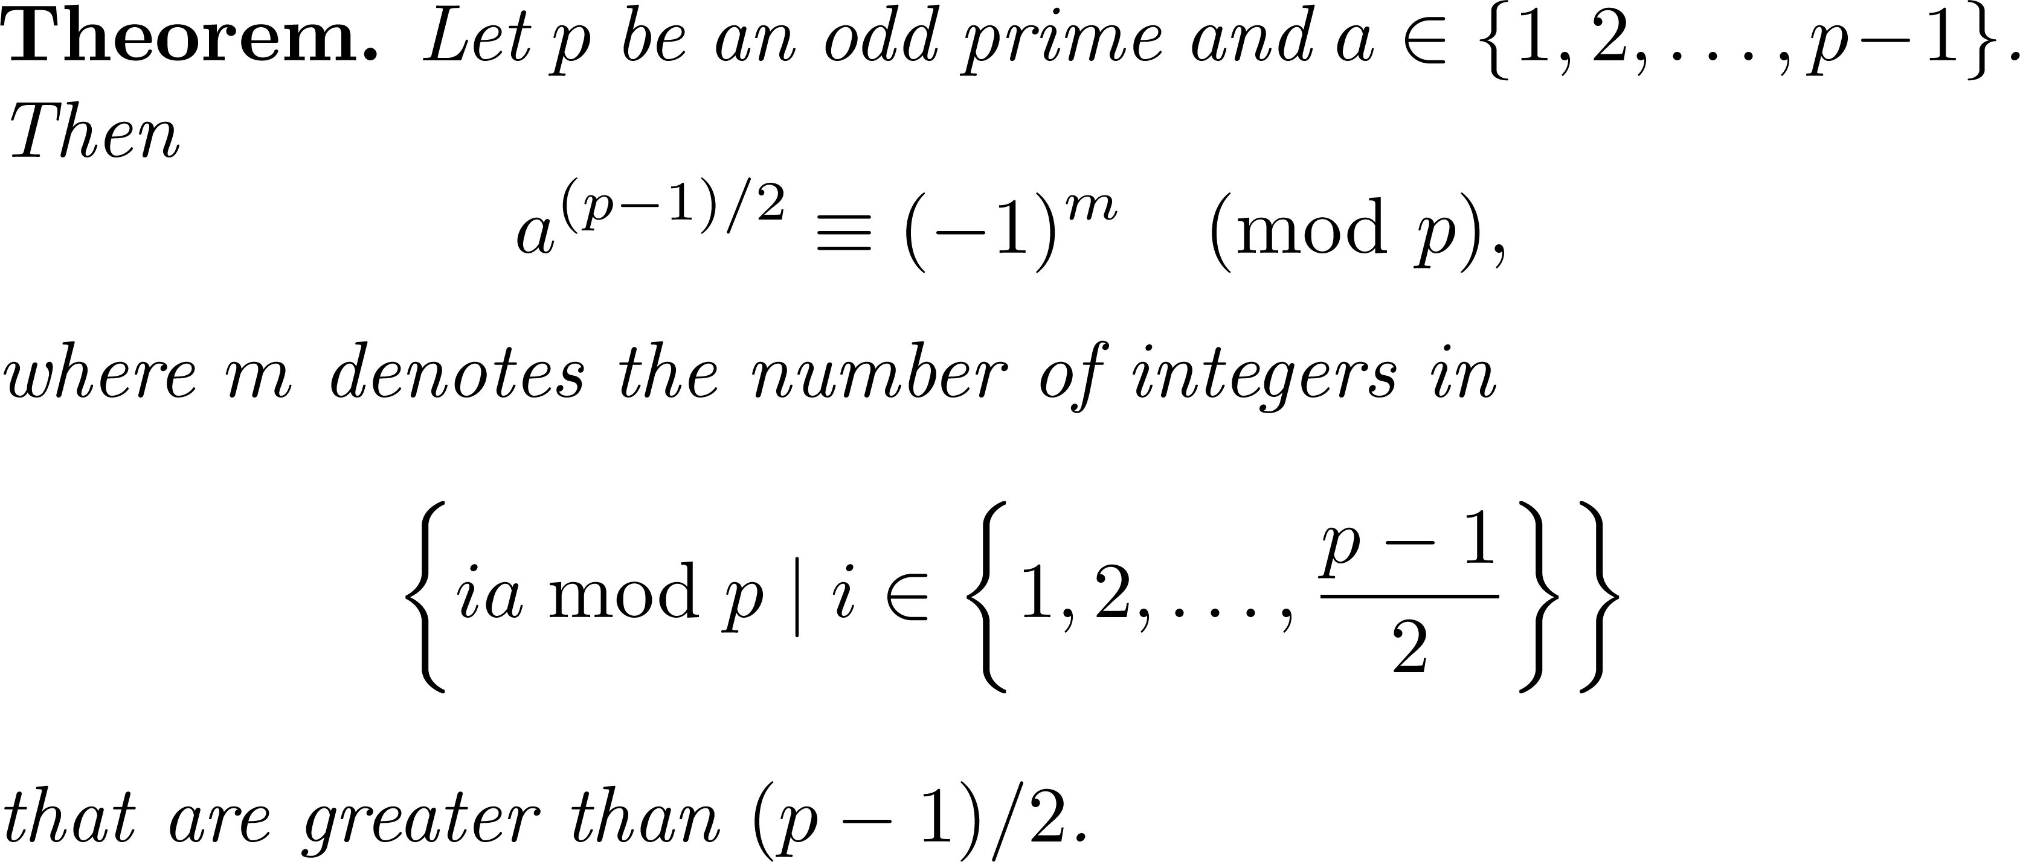

A theorem of Gauss

Slide 19
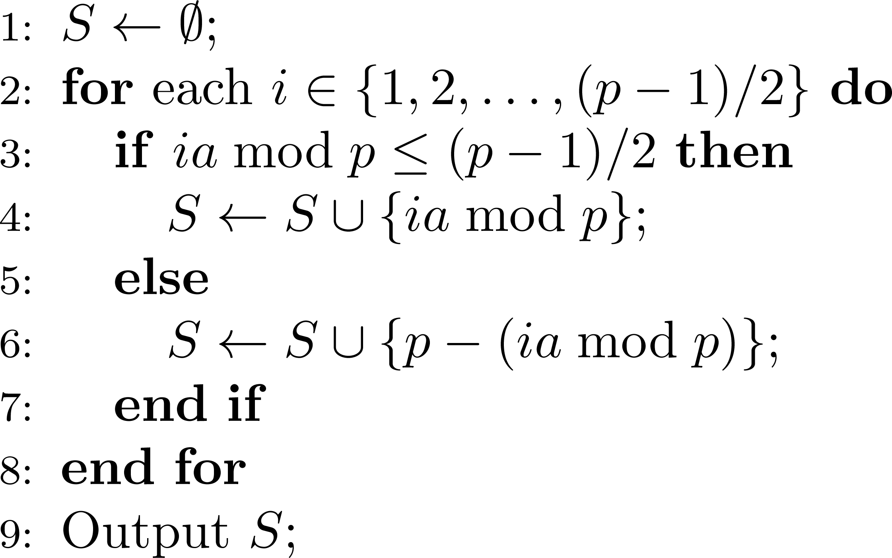
Proof (1/3)

Slide 20
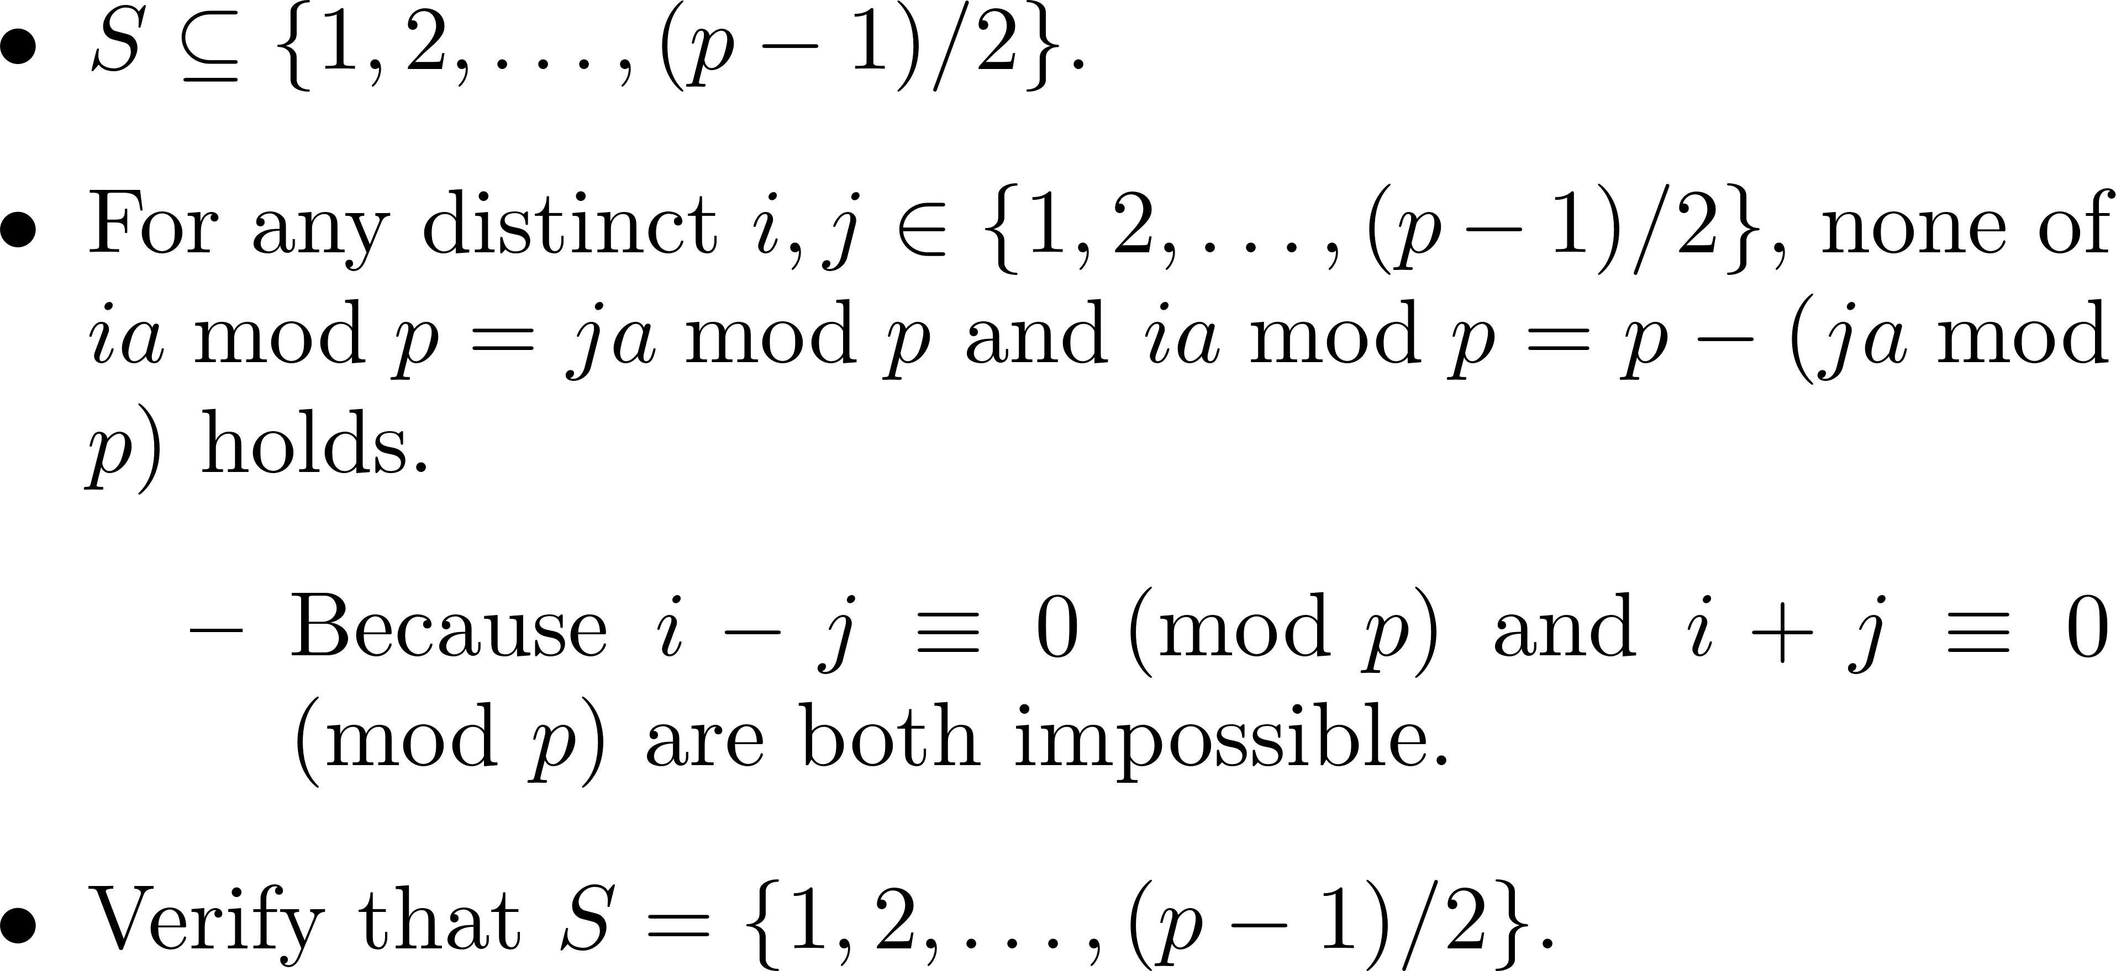
Proof (2/3)

Slide 21
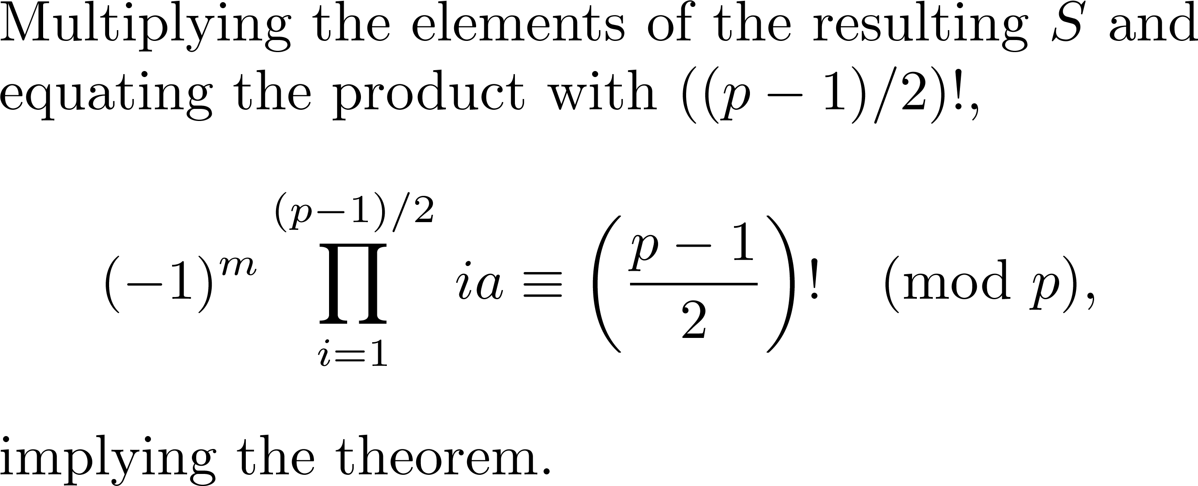
Proof (3/3)

Slide 22
Comments?

